Slide 2

TIMC COLLOQUIUM
MetaTriage / 01
MetaTriage
A Meta-Methodology for Testing Cyber Telemetry Triage Methods Across Datasets
Mekael Wasti
TIMC - Queen's University
August 11th 2026
Notes:
Establish that this is a methodology and systems talk, not a claim that one model wins. The deck moves from cyber telemetry to the mathematical machinery and back to a decision.

Slide 3
TIMC COLLOQUIUM
Network telemetry
time
process
user
host
file
MetaTriage
time
source IP
destination IP
port
bytes
09:14:02
powershell
j.dupont
WS-114
setup.tmp
09:14:02
10.0.4.12
10.0.0.5
443
18 204
09:14:07
rundll32
j.dupont
WS-114
setup.tmp
09:14:05
10.0.4.12
203.0.113.9
53
61
09:15:31
explorer
m.roux
WS-207
—
A Meta-Methodology for Systematically Evaluating Cyber Telemetry Triage Methods Across Datasets
09:15:44
10.0.7.31
10.0.0.5
445
2 990
Mekael Wasti
TIMC - Queen's University
August 11th 2026
Notes:
Establish that this is a methodology and systems talk, not a claim that one model wins. The deck moves from cyber telemetry to the mathematical machinery and back to a decision.

Slide 4
BACKGROUND
Cybersecurity Begins With Records Of Activity
Telemetry Is A Stream Of Records Describing What Machines, Users, Processes, and Network Connections Are Doing.
Process Telemetry
Network Telemetry
time
process
user
host
file
time
source IP
destination IP
port
bytes
09:14:02
powershell
j.dupont
WS-114
setup.tmp
09:14:02
10.0.4.12
10.0.0.5
443
18 204
09:14:07
rundll32
j.dupont
WS-114
setup.tmp
09:14:05
10.0.4.12
203.0.113.9
53
61
09:15:31
explorer
m.roux
WS-207
—
09:15:44
10.0.7.31
10.0.0.5
445
2 990
Each row represents one recorded event or network flow
Each column represents a feature
A distinct unit of information recorded for each event
Notes:
Give the mathematical audience enough cyber context to read the data. Telemetry is just a stream of typed records. Point at the highlighted rows: these are the raw observations everything else is built from.

Slide 5
BACKGROUND · THE DATA
Cybersecurity Begins With Records Of Activity
The analyst chooses which feature columns to keep
Process Telemetry
Network Telemetry
time
process
user
host
file
time
source IP
destination IP
port
bytes
09:14:02
powershell
j.dupont
WS-114
setup.tmp
09:14:02
10.0.4.12
10.0.0.5
443
18 204
09:14:07
rundll32
j.dupont
WS-114
setup.tmp
09:14:05
10.0.4.12
203.0.113.9
53
61
09:15:31
explorer
m.roux
WS-207
—
09:15:44
10.0.7.31
10.0.0.5
445
2 990
Feature Selection
Selecting which units of information really matter
Leverages domain insight and intuition -> individual decision-making
Sessionization
Grouping records in a way that represents coherent sessions
Notes:
Give the mathematical audience enough cyber context to read the data. Telemetry is just a stream of typed records. Point at the highlighted rows: these are the raw observations everything else is built from.

Slide 6
BACKGROUND
The Typical Analyst Procedure
Cyber Threat Analysts work with this data to try to uncover potentially malicious activity
This data needs to be manually ingested, wrangled, pre-processed, modelled, etc.
Threat intel researchers will employ scientific methods to build better anomaly detection pipelines and methods (Embedding Methods, DS techniques/models, visualization tools)
Analysts use these tools to execute better triage and save time finding malicious behaviour
Notes:
Give the mathematical audience enough cyber context to read the data. Telemetry is just a stream of typed records. Point at the highlighted rows: these are the raw observations everything else is built from.

Slide 7
BACKGROUND · THE PROBLEM
The Problem
There is no shared standard for creating, testing, and evaluating anomaly detection protocols
Analysts
Must rely on specialized methods
May or may not translate well outside of niche contexts
Researchers
No universal evaluation method
Niche methods with niche results
Methods collapse under different contexts
Notes:
Give the mathematical audience enough cyber context to read the data. Telemetry is just a stream of typed records. Point at the highlighted rows: these are the raw observations everything else is built from.

Slide 8
MOTIVATION
Different Datasets Expose Different Behaviour
Process Telemetry
Network Flows
Authentication Events
users · hosts · parent processes · files
source IPs · destination IPs · ports · protocols
accounts · machines · login times · outcomes
Isolated Event
Coherent Rare Population
Unusual Relationship Pattern
Entities differ — Process data has users and files; flow data has addresses and ports. The graphs are not comparable
So does the right method — A detector tuned to isolated points cannot see a rare population
Anomaly shape differs — One dataset hides single outliers, another hides small coherent groups
A method can succeed because it matches one dataset's structure — not because it is universally best.
Notes:
Motivation for systematic comparison, not an accusation. Each dataset exposes different entities and therefore different kinds of anomalous structure; a method can match one structure and fail on another.

Slide 9
MetaTriage
Raw Telemetry (Agent Ingested)
Fixed Review Units
Typed Telemetry Relations
Represent Behavior
01
02
03
04
The system starts with the columns & relationships available in a dataset
Deterministic code creates the same fixed review units for every method
Review units are connected to the entities they interacted with
Five ways to describe the same review units. Each one runs on its own.
Produce Triage Scores
Ranked Analyst Review Queue
Evaluate The Queue
Diagnosis
06
07
08
05
Compare the methods against controls & evaluation metrics
Each scorer produces one priority score for each review unit. No labels used.
Sort the scores from highest to lowest to create the review queue
Recommend
Explore
Abstain
Labels evaluate the queue. They do not create the ranking.
Record and report to the analyst
Notes:
Give the mathematical audience enough cyber context to read the data. Telemetry is just a stream of typed records. Point at the highlighted rows: these are the raw observations everything else is built from.

Slide 10
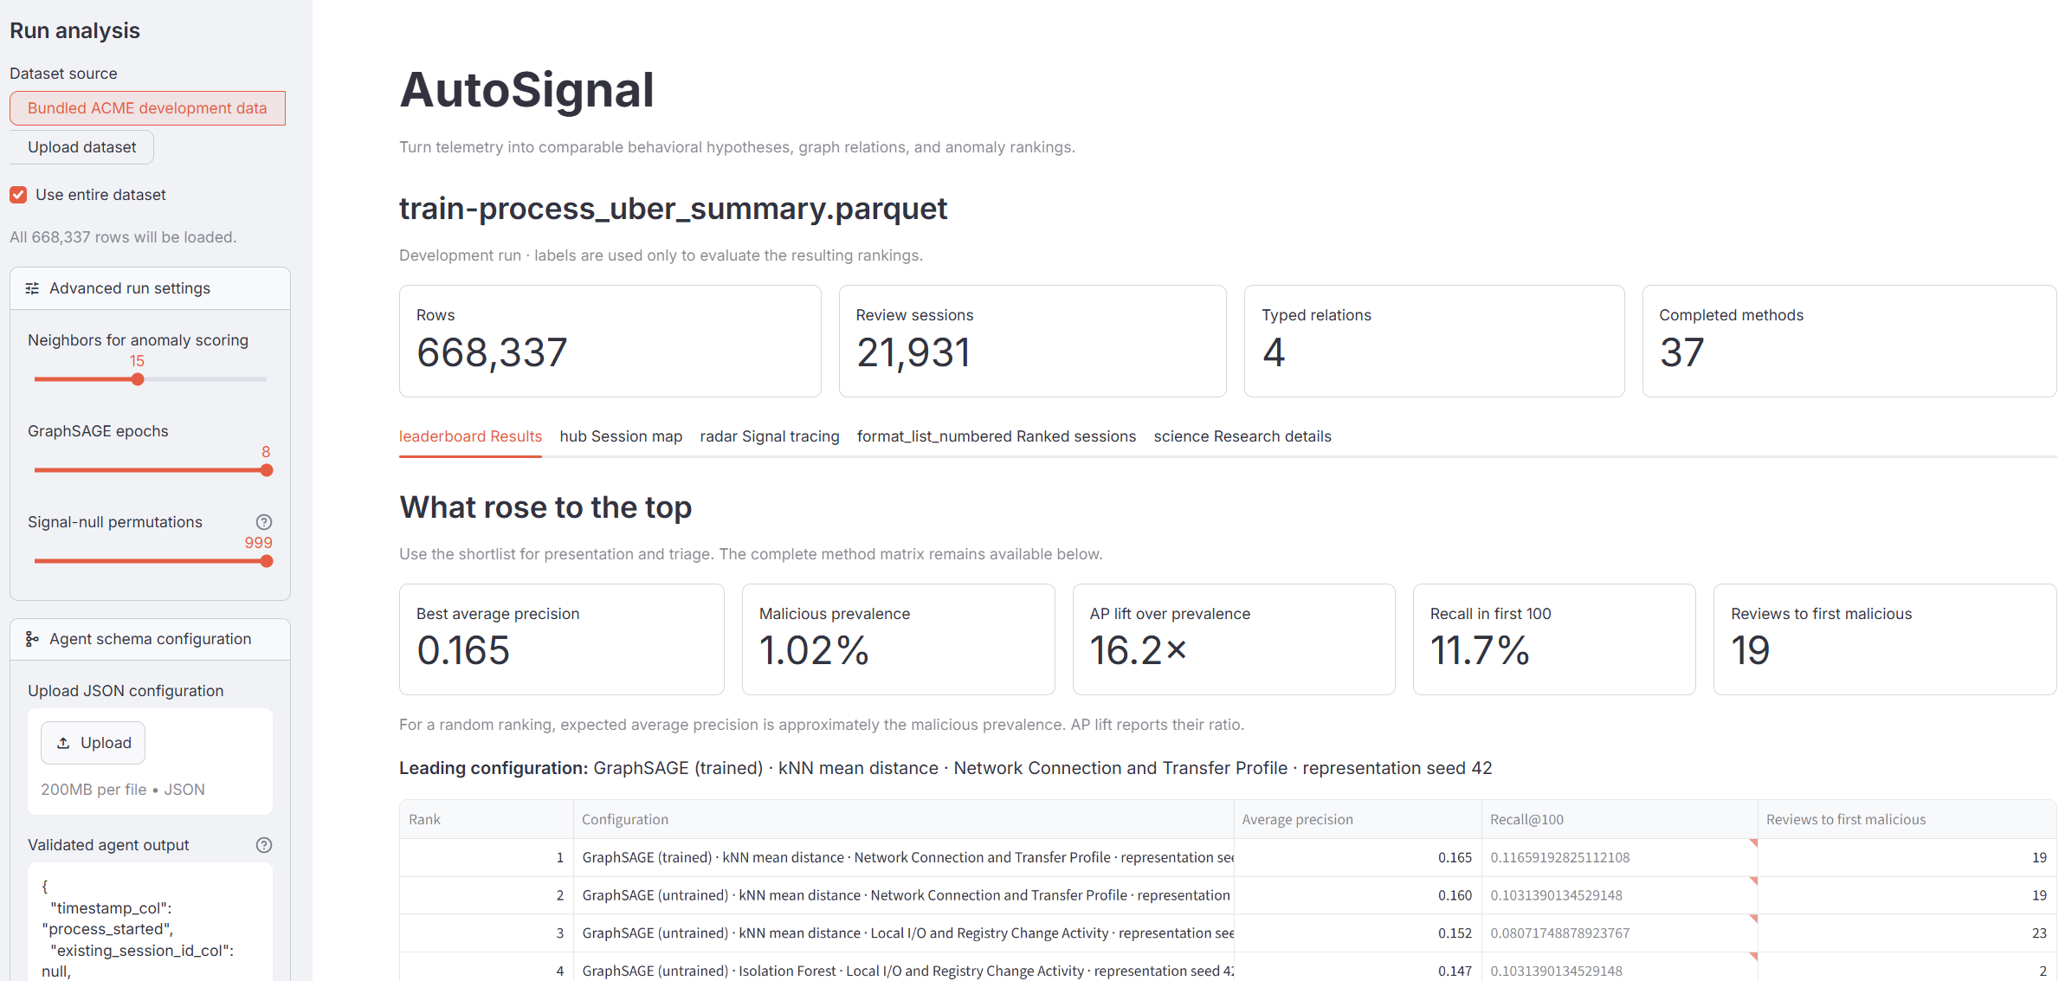
THE METHODOLOGY
{
"session_group_cols": ["hostname", "user_name"],
"timestamp_col": "process_started",
"graph_relations": [
{ "parent_of": "process → process" },
{ "executes": "process → executable" },
{ "runs_on": "process → host" },
{ "owned_by": "process → user" }
],
"feature_sets": [
{ "compute_memory": ["cpu_cycle_count", "commit_charge", "commit_peak"] },
{ "io_registry": ["read_ops", "write_ops", "reg_reads", "reg_writes", "reg_createkeys"] },
{ "network": ["tcp_connect_count", "tcp_send_size", "tcp_recv_size", "net_total_events"] }
],
"label_col": "red_team"
}
Proposed by the agent. Validated. Then applied deterministically to every row, identically for every method.
Notes:
The overview slide. Walk the eight stages once, slowly. Emphasise that stages 5 to 7 are the scientific part and that stage 8 can end in abstention. Labels only judge the queue at stage 7; they never build it.

Slide 11
THE METHODOLOGY
Canonical Review Units
A real process-telemetry dataset, grouping, typed relations, and feature sets, before any model runs.
SESSION GROUPING
timestamp
process_started
FEATURE SETS
grouped by
hostname · user_name
Computational & memory footprint
label
red_team = 1
CPU cycles · commit charge · commit peak — unusual intensity or memory demand
TYPED RELATIONS
Local I/O & registry change
Read/write ops · registry reads, writes, key creation — access and modification behavior
Connection & transfer profile
TCP connects · send/recv size · total network events — connection frequency and volume
Notes:
The overview slide. Walk the eight stages once, slowly. Emphasise that stages 5 to 7 are the scientific part and that stage 8 can end in abstention. Labels only judge the queue at stage 7; they never build it.

Slide 12
THE METHODOLOGY
Relationships in the Data Become a Typed Graph
PROCESS SIDE, SAME CONSTRUCTION
Filled circles are review units. Outlined circles are entities. Solid cyan edges are observed relationships.
Notes:
Stage 2. Nodes are review units and entities; typed edges are relationships actually recorded in the data. Stress that this graph is observed, not computed from any similarity measure.

Slide 13
THE METHODOLOGY
How to Represent the Dataset’s Behaviour?
Raw Features
Measured behaviour, aggregated per unit
Structural Statistics
Explicit graph roles — degree, typed neighbours
Node2Vec
Topology via random-walk neighbourhoods
GraphSAGE
Features combined with graph neighbourhoods
DOMINANT-style
Attribute-and-structure reconstruction
Notes:
The overview slide. Walk the eight stages once, slowly. Emphasise that stages 5 to 7 are the scientific part and that stage 8 can end in abstention. Labels only judge the queue at stage 7; they never build it.

Slide 14
THE METHODOLOGY
Produce Triage Scores
representation × scorer → ranked review queue
kNN
far from its neighbours
Isolation Forest
individually easy to isolate
HDBSCAN
member of a rare coherent population
Reconstruction
hard for the model to explain
A cross-product alone just produces more numbers. What makes them evidence is what they are compared against.
Labels enter only at evaluation. Never at construction.
Controls distinguish useful behaviour from architecture, randomness, and dataset shortcuts.
Random Rankings
Untrained Models
Permuted Relations
Repeated Seeds
Alternative Feature Selections
Multiple Datasets
Notes:
The overview slide. Walk the eight stages once, slowly. Emphasise that stages 5 to 7 are the scientific part and that stage 8 can end in abstention. Labels only judge the queue at stage 7; they never build it.

Slide 15
THE METHODOLOGY
MetaTriage
Notes:
The overview slide. Walk the eight stages once, slowly. Emphasise that stages 5 to 7 are the scientific part and that stage 8 can end in abstention. Labels only judge the queue at stage 7; they never build it.

Slide 16
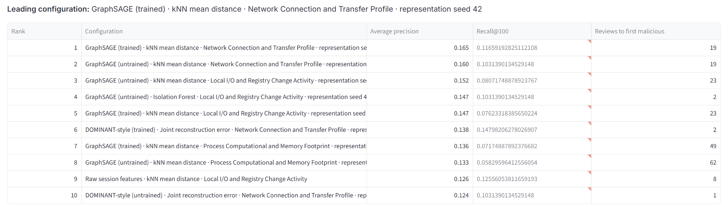
THE METHODOLOGY
Notes:
The overview slide. Walk the eight stages once, slowly. Emphasise that stages 5 to 7 are the scientific part and that stage 8 can end in abstention. Labels only judge the queue at stage 7; they never build it.

Slide 17
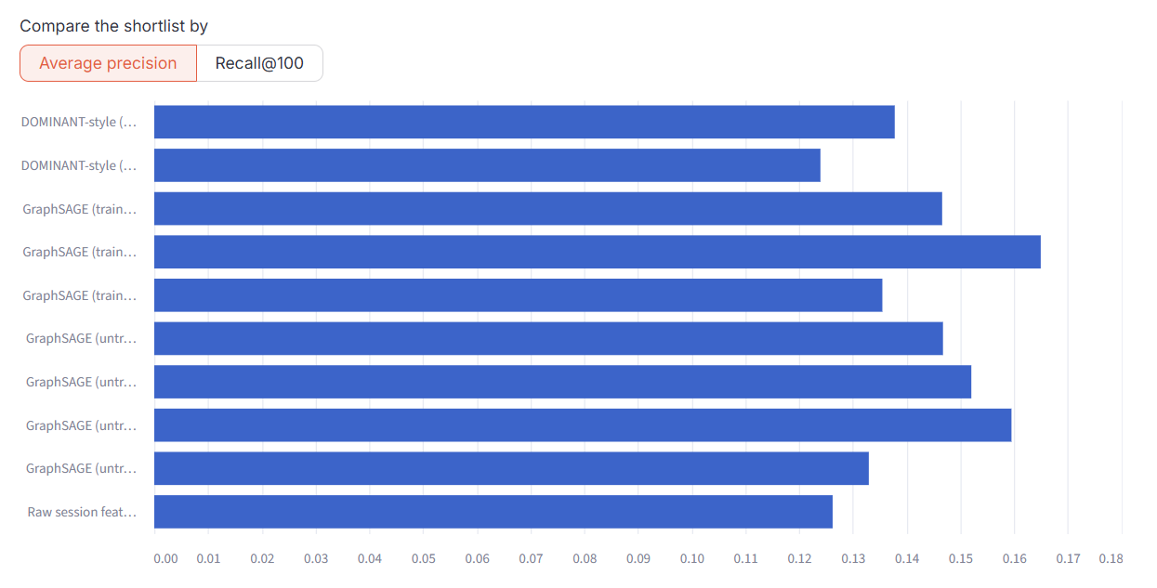
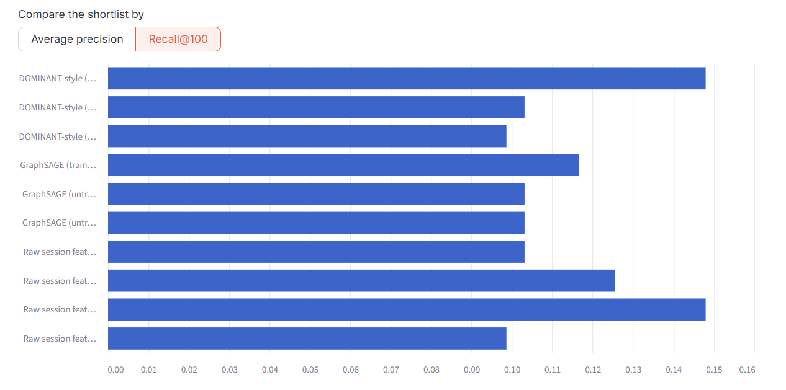
THE METHODOLOGY
Average Precision Winner:
GraphSAGE (Trained) kNN mean distance
Network Connection and Transfer profile:
0.165
Untrained version 0.159
Recall@100 Winner:
DOMINANT-Style Joint Reconstruction error – Network Connection and Transfer Profile
0.147
Tie with Raw sessions of the same behaviour set
Notes:
The overview slide. Walk the eight stages once, slowly. Emphasise that stages 5 to 7 are the scientific part and that stage 8 can end in abstention. Labels only judge the queue at stage 7; they never build it.

Slide 18
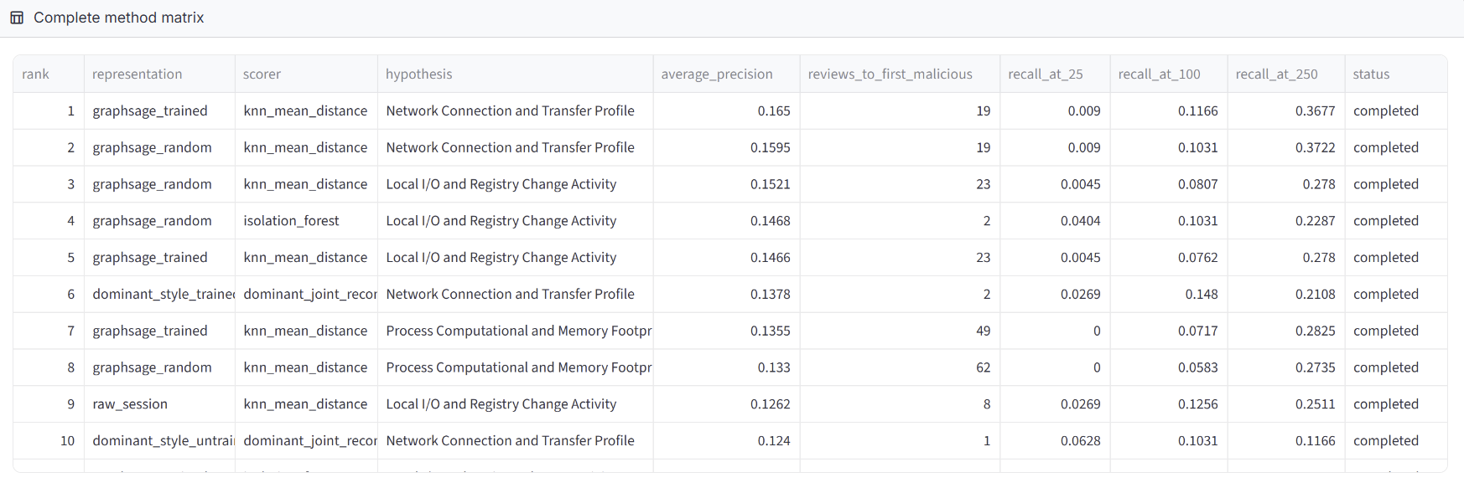
THE METHODOLOGY
Notes:
The overview slide. Walk the eight stages once, slowly. Emphasise that stages 5 to 7 are the scientific part and that stage 8 can end in abstention. Labels only judge the queue at stage 7; they never build it.

Slide 19
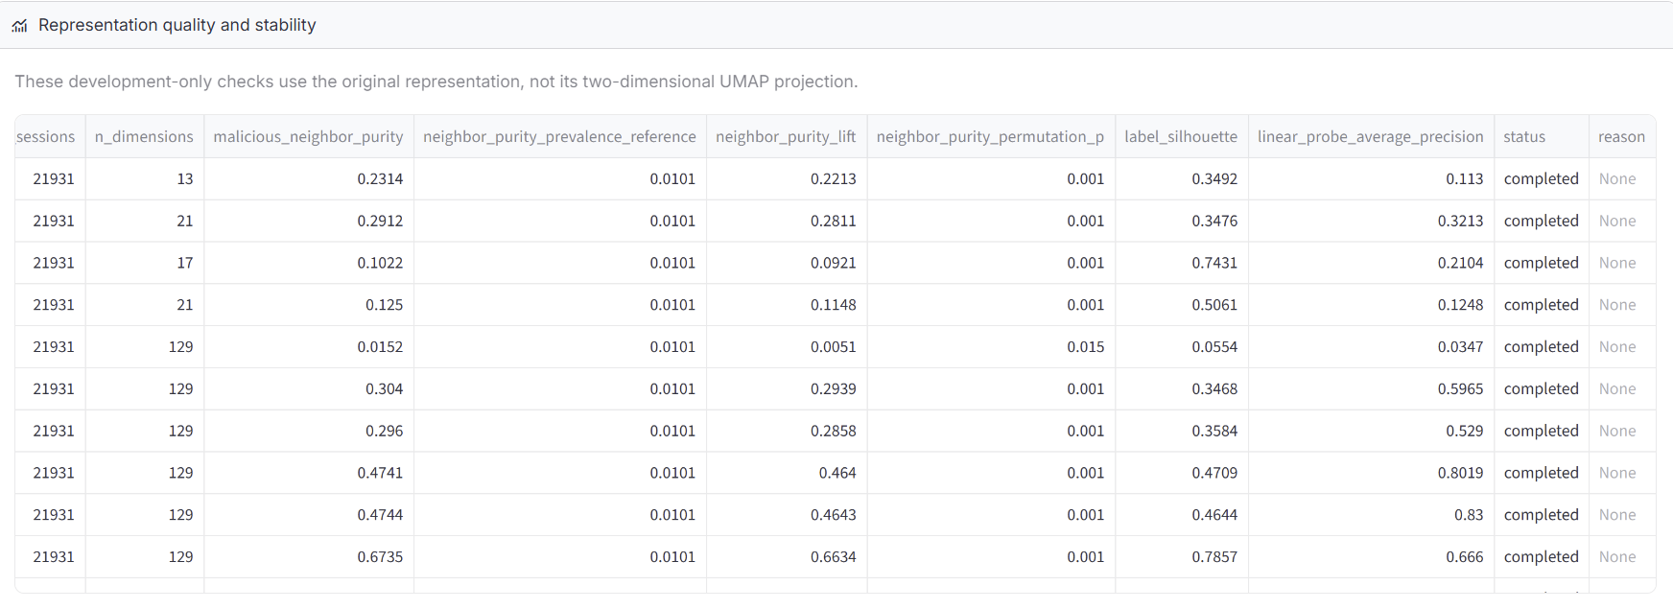
THE METHODOLOGY
Notes:
The overview slide. Walk the eight stages once, slowly. Emphasise that stages 5 to 7 are the scientific part and that stage 8 can end in abstention. Labels only judge the queue at stage 7; they never build it.

Slide 20
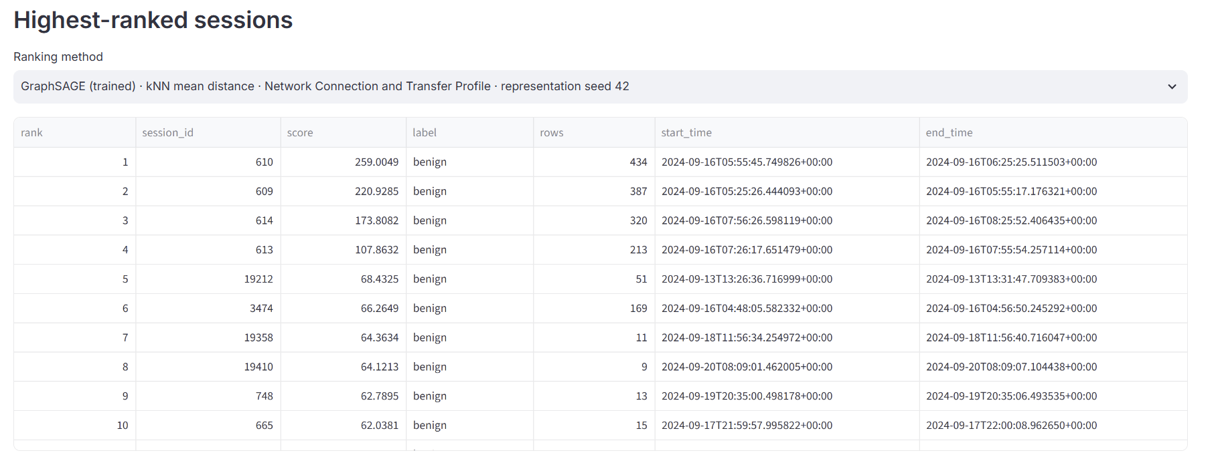
THE METHODOLOGY
Notes:
The overview slide. Walk the eight stages once, slowly. Emphasise that stages 5 to 7 are the scientific part and that stage 8 can end in abstention. Labels only judge the queue at stage 7; they never build it.

Slide 21
THE METHODOLOGY
Signal Geometry
representation vectors
dotted kNN similarity graph
anomaly signal s on the graph
Here, neighbouring review units are mathematically similar — not necessarily connected in the original telemetry.
Neighbourhood-supported
Locally contrastive
Intermediate-scale
High scores have high-scoring neighbours.
High scores rise above their neighbours.
One-hop pockets weaken at two hops.
Ps
s − Ps
Ps − P²s
This explains how a ranking is organized before labels are used to assess its usefulness
Notes:
The overview slide. Walk the eight stages once, slowly. Emphasise that stages 5 to 7 are the scientific part and that stage 8 can end in abstention. Labels only judge the queue at stage 7; they never build it.

Slide 22
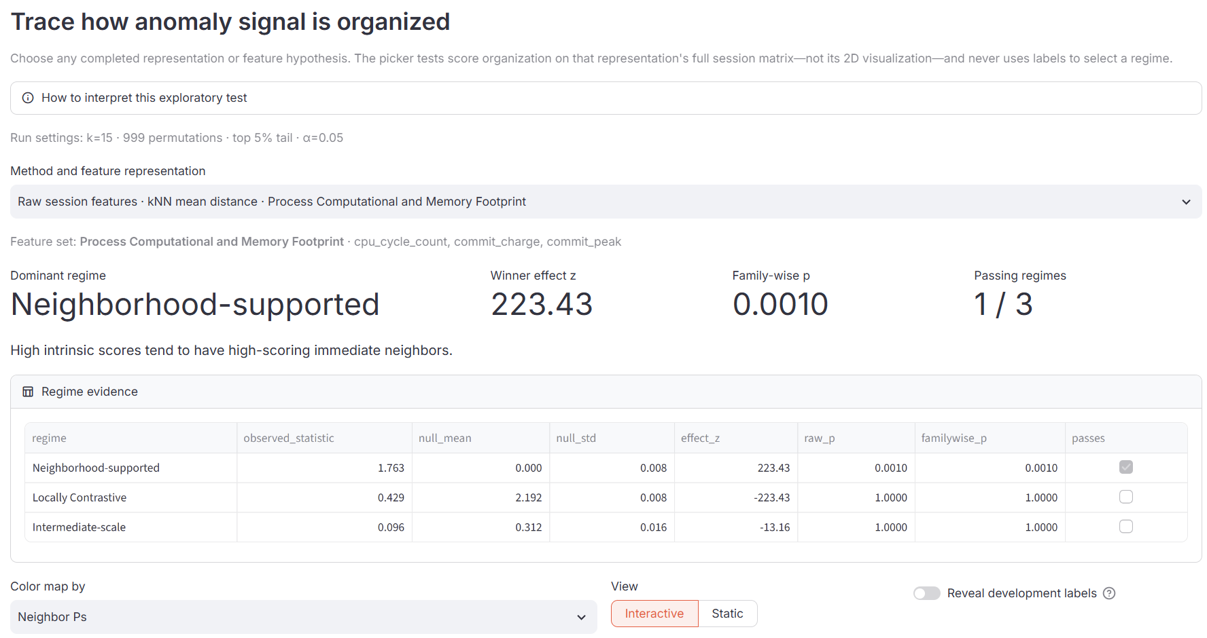
THE METHODOLOGY
Signal Geometry
Notes:
The overview slide. Walk the eight stages once, slowly. Emphasise that stages 5 to 7 are the scientific part and that stage 8 can end in abstention. Labels only judge the queue at stage 7; they never build it.

Slide 23
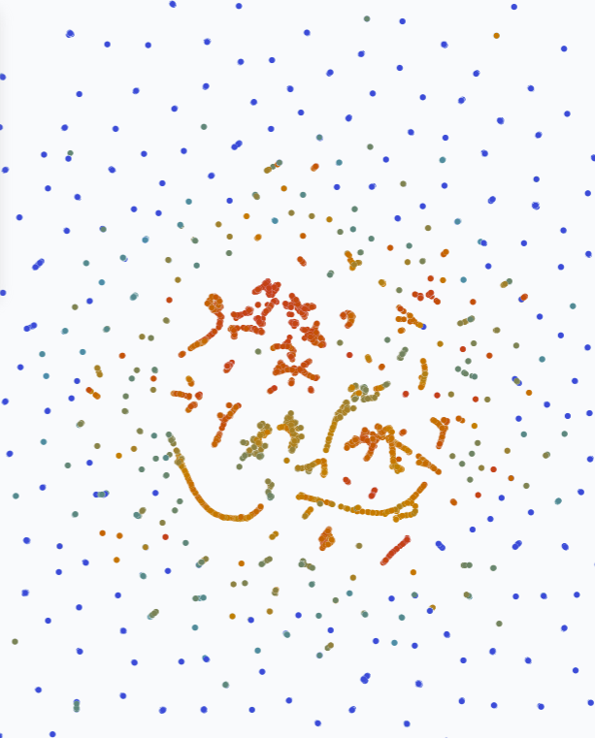
THE METHODOLOGY
GraphSAGE (trained)
kNN mean distance
Network Profile
· Neighbor Ps
Notes:
The overview slide. Walk the eight stages once, slowly. Emphasise that stages 5 to 7 are the scientific part and that stage 8 can end in abstention. Labels only judge the queue at stage 7; they never build it.

Slide 24
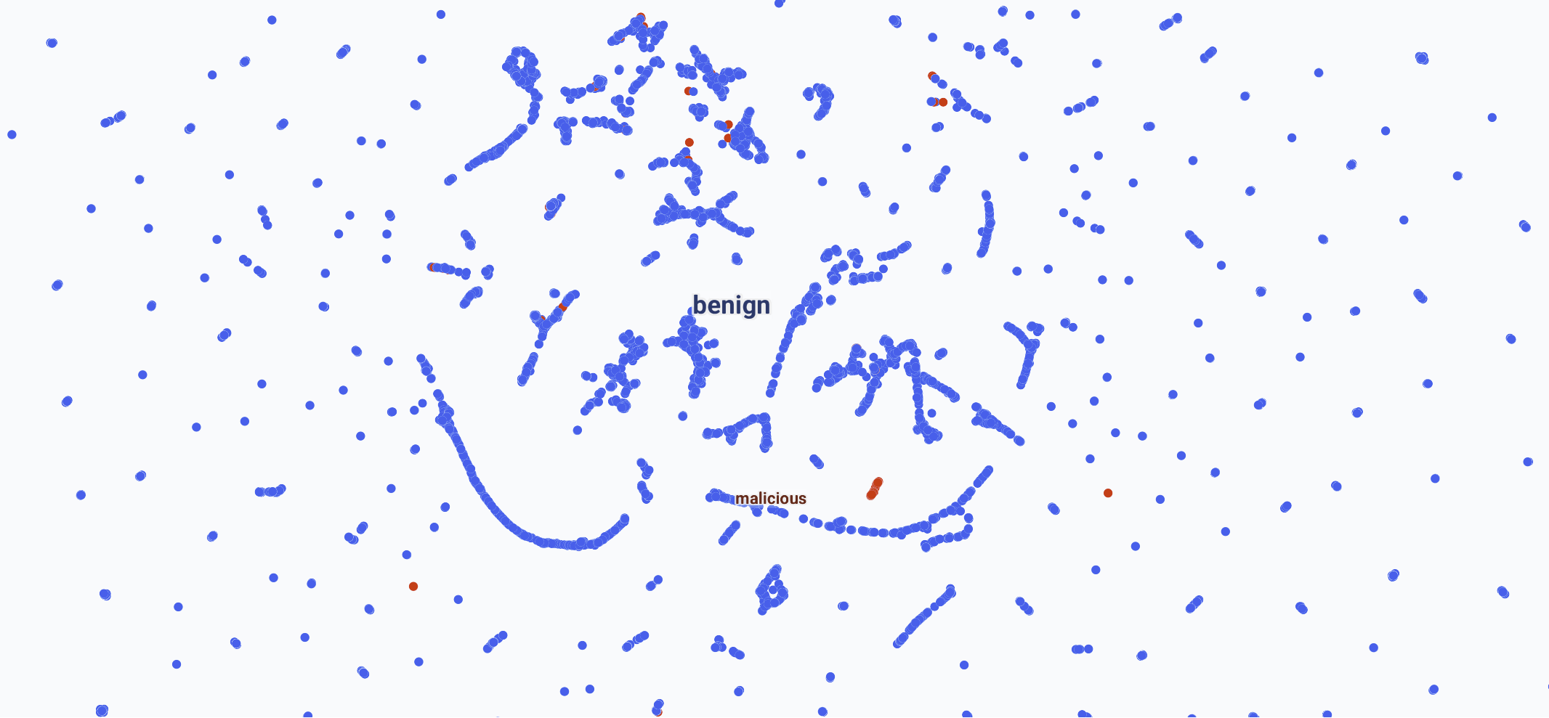
Notes:
The overview slide. Walk the eight stages once, slowly. Emphasise that stages 5 to 7 are the scientific part and that stage 8 can end in abstention. Labels only judge the queue at stage 7; they never build it.

Slide 25
Notes:
The overview slide. Walk the eight stages once, slowly. Emphasise that stages 5 to 7 are the scientific part and that stage 8 can end in abstention. Labels only judge the queue at stage 7; they never build it.

Slide 26
Notes:
The overview slide. Walk the eight stages once, slowly. Emphasise that stages 5 to 7 are the scientific part and that stage 8 can end in abstention. Labels only judge the queue at stage 7; they never build it.

Slide 27
Notes:
The overview slide. Walk the eight stages once, slowly. Emphasise that stages 5 to 7 are the scientific part and that stage 8 can end in abstention. Labels only judge the queue at stage 7; they never build it.

Slide 28
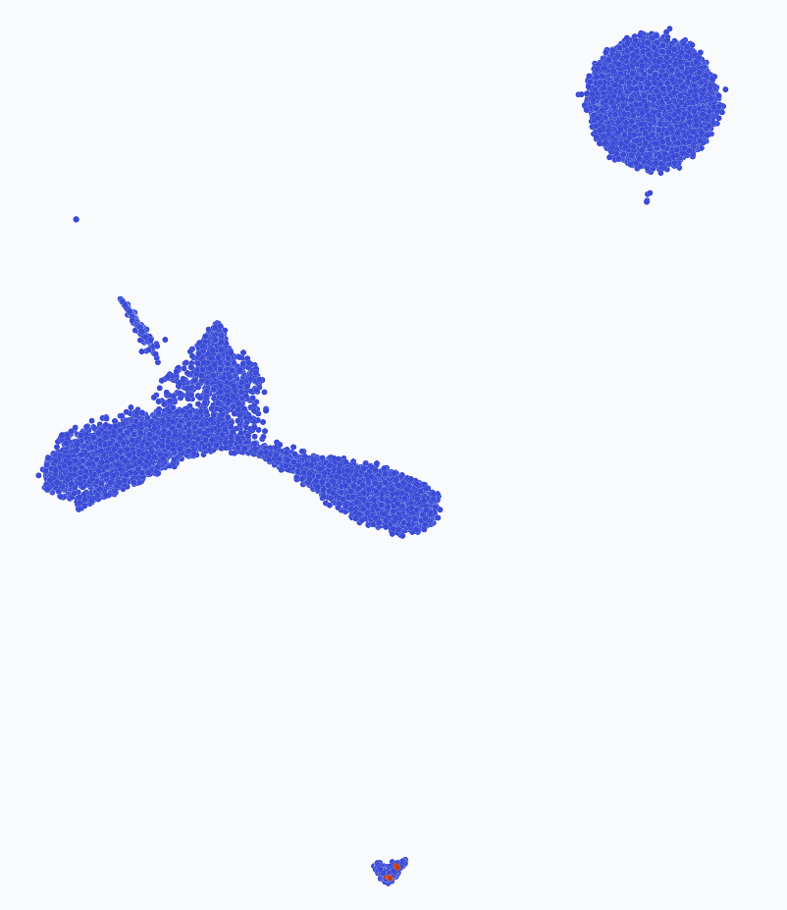
Node2Vec / DeepWalk HDBSCAN rare population
Notes:
The overview slide. Walk the eight stages once, slowly. Emphasise that stages 5 to 7 are the scientific part and that stage 8 can end in abstention. Labels only judge the queue at stage 7; they never build it.

Slide 29
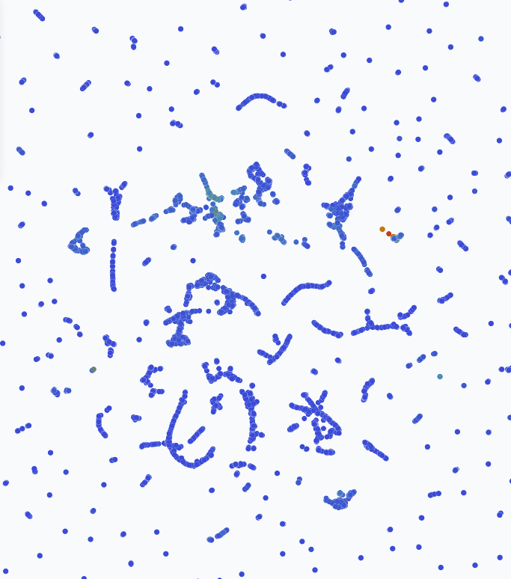
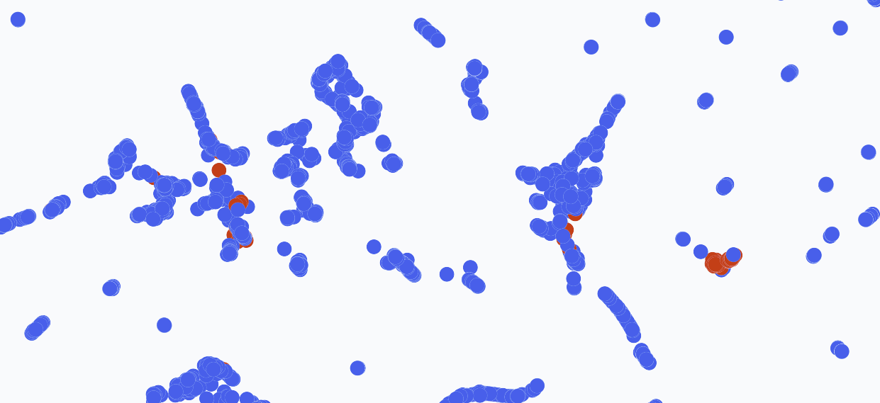
DOMINANT-style (trained) Joint reconstruction error Network Profile
Malicious Labels
Anomaly Score
Notes:
The overview slide. Walk the eight stages once, slowly. Emphasise that stages 5 to 7 are the scientific part and that stage 8 can end in abstention. Labels only judge the queue at stage 7; they never build it.

Slide 30
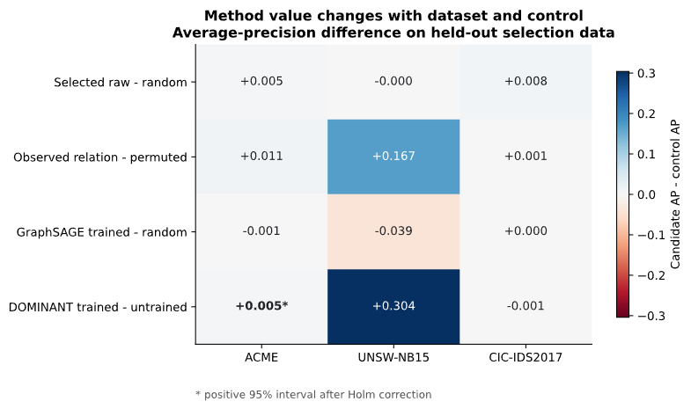
EVALUATION
No Method Prevailed Across Every Dataset & Control
Dataset (frozen) | Highest-AP configuration | AP | Recall@100
ACME | GraphSAGE + Isolation Forest | 0.0498 | 66.7%
CIC-IDS2017 | Raw features + Isolation Forest | 0.0373 | 0%
UNSW-NB15 | DOMINANT + reconstruction | 0.5845 | 0%
Different datasets favoured different combinations
Some methods were useful under particular conditions
No method consistently beat its controls, led every dataset, and produced useful early-review rankings.
Notes:
Stage 7 and 8 in practice. Read the matrix as directions, not scores. The headline fields are placeholders until verified. Emphasise that the procedure kept the negative results.

Slide 31
CONTRIBUTION
The Contribution is the Procedure
Not a Universal Detector
MetaTriage turns method selection from an implicit search into an explicit, controlled, and reproducible analysis
Detect
Digest
Evaluate
Test
Find candidate anomalous structure
Explain representations, controls, and signal geometry
Propose one behaviourally justified method
Compare it once against a declared control
If a universal method exists, this is a way to find and verify it. If it does not, this is a way to show where and why methods differ.
Notes:
State the contribution without naming a winning model. The four-step loop is how the procedure is meant to be used going forward.

Slide 32
QUESTIONS
Questions
What should remain fixed? What should adapt when telemetry behaviour changes?
Notes:
Open the floor with the framing question: what should stay fixed and what should adapt when telemetry behaviour changes?

